Slide 1
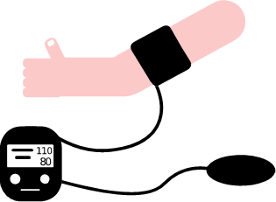
BANNARI AMMAN INSTITUTE OF TECHNOLOGY
FINGERPRINT INTEGRATED
E-HEALTH MONITORING SYSTEM USING IOT
DEPARTMENT OF
ELECTRONICS AND COMMUNICATION ENGINEERING
GUIDED BY
Mr S. Elango
Assistant Professor Level II
BIT, Sathy.
PRESENTED BY
N.Keerthana
K.Lokeshwaran
P S.Kavin Kumar
T.Kaviyan
M.Manimaran
BE(ECE) – III YEAR

Slide 2
OUTLINE
Area of work
Objectives
Introduction
Literature Survey
Existing Model
Proposed Work
Results
Conclusion
Future work
References

Slide 3
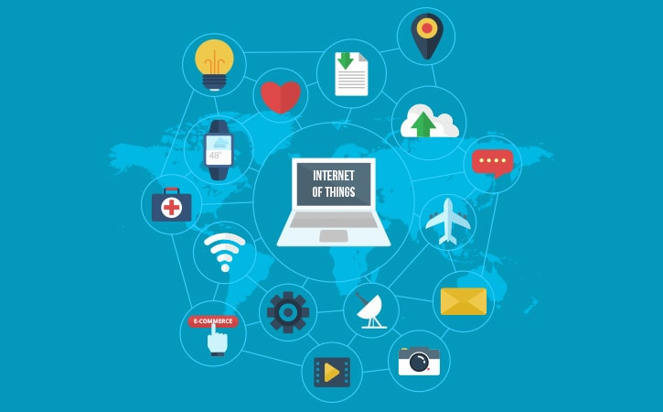
Area of Work
IOT
Internet of Things is a platform which connects everything over internet.
Standard features of IOT :
Connectivity
Analysing
Integration
Visualisation
IOT in E-Health :
Data storage
Patient data monitoring
Analysing
Prediction of disease at early stage

Slide 4
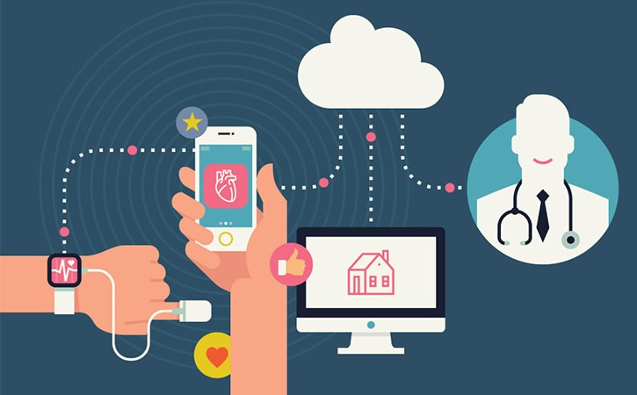
Objectives
To get real-time medical information of the patient via IOT.
Ensures sensor working ,security and alert system.
Physicians can provide IOT based medical assistance at any time and anywhere.
Doctors can diagnose and treat the disease in the preliminary stage.

Slide 5
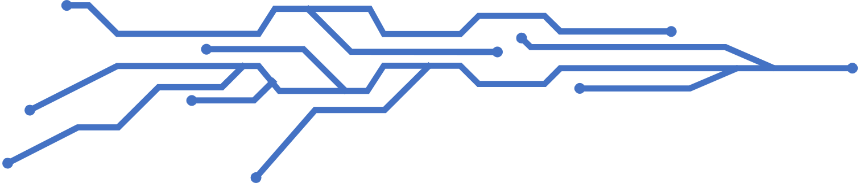
Introduction
E-Health monitoring using IOT provides smart, reliable health care services.
Biomedical sensors – monitors health parameter.
Working :
Easy monitoring in home
Reduces often visit to doctor
Data maintenance and observation
Proper medications at right time

Slide 6
Literature survey
S.NO | AUTHORS | TITLE | WORKING OF MODEL | YEAR
1 | Orge Gomez, Byron Oviedo, Emilio Zhuma. | Patient Monitoring System Based on Internet of Things | M-Health application monitors health and workout routine | 2016
2 | Shivleela Patil, Sanjay Pardeshi . | Health Monitoring System Using IOT | Health monitoring and data maintenance | 2018
3 | Shubhan Banka, Isha Madan , S.S. Saranya. | Smart Health Monitoring Using IOT | IOT based Health monitoring and earlier prediction of disease | 2018
4 | Surekha N, Yamuna N, AkhilKumar J, Naveen Kumar KG, Rajesh Kumar Kaushal. | Patient monitoring system using IOT | Portable Tele-Health monitoring system | 2018

Slide 7
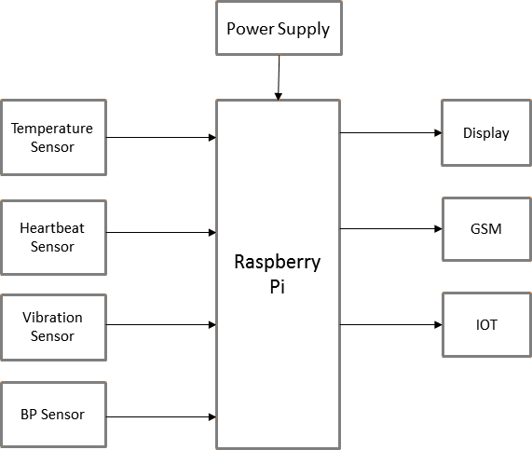
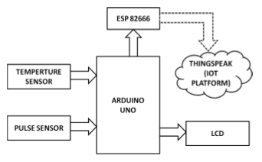
Existing Model
Method 1
Raspberry pi
1 . Smart health monitoring using IOT
Biomedical sensors – connected with Raspberry pi.
Health monitoring and prediction of disease in advance.
Health parameters - Cloud , LCD , Message (GSM)
2. Health monitoring using IOT
Biomedical sensors – connected with Arduino UNO
Data – stores in cloud via ESP8266 Wi-Fi module
Health parameters - LCD
Method 2
Arduino UNO

Slide 8
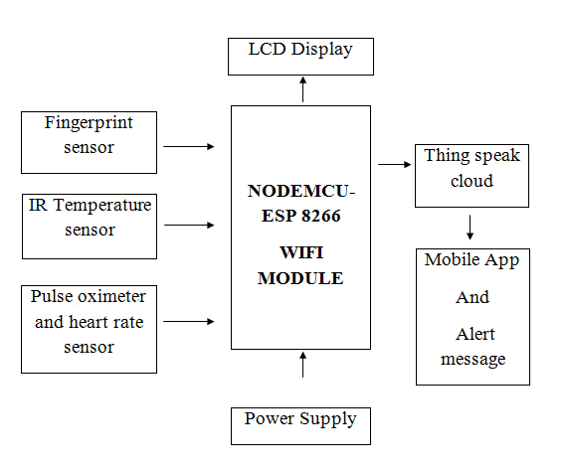
Proposed Model
SYSTEM ARCHITECTURE
BLOCK DIAGRAM
Security alert system
Fingerprint sensor - ensures data security of an individual.
Health monitoring system
Temperature sensor
Pulse oximeter NodeMCU(ESP8266)
Heart rate sensor
Data from sensors are stored in cloud .
Emergency alert system
Data comparison in cloud
Alerts doctor and guardian through message

Slide 9


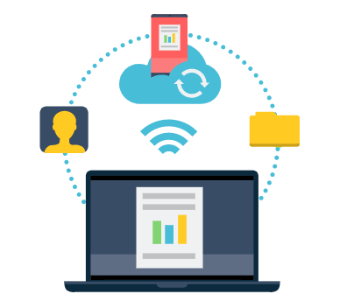



SECURITY ALERT SYSTEM
Proposed Model
EMERGENCY ALERT SYSTEM
HEALTH MONITORING SYSTEM

Slide 10
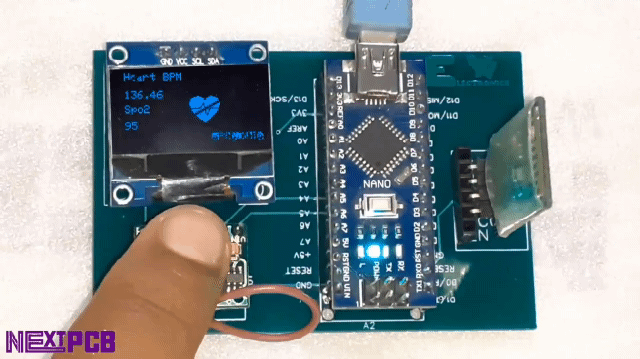
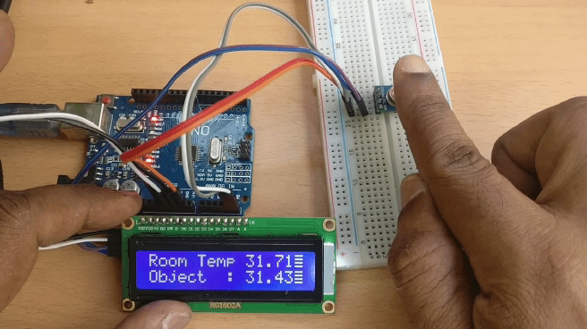
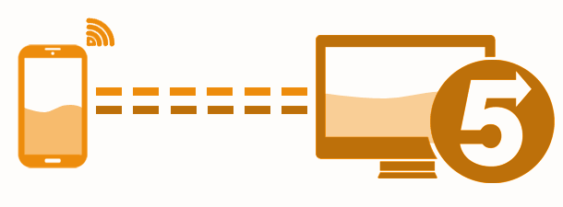
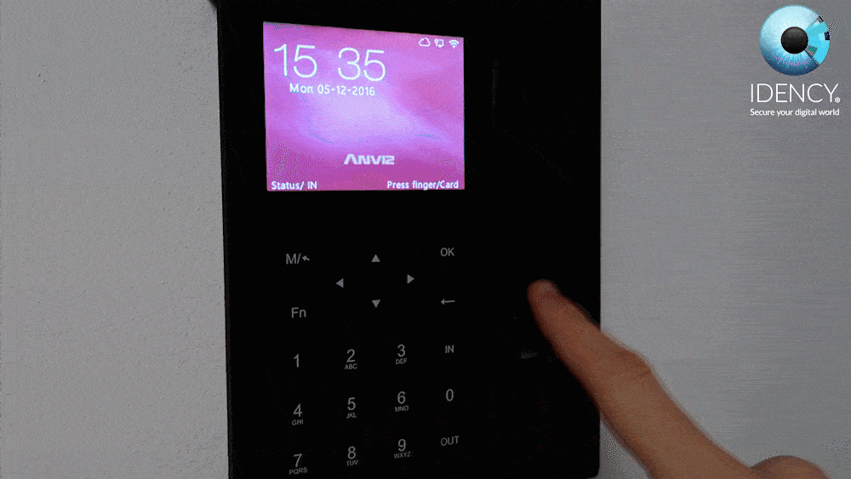


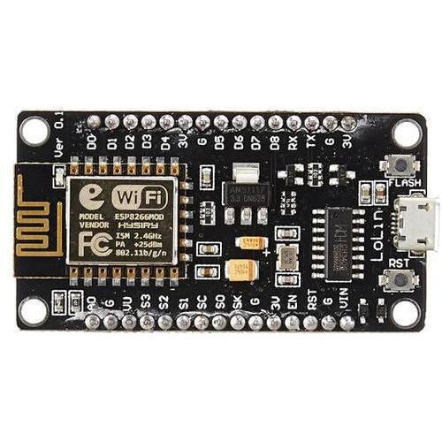

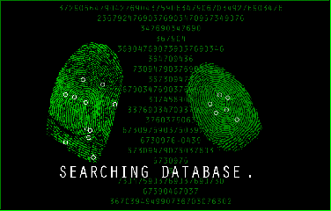
Results

Slide 11

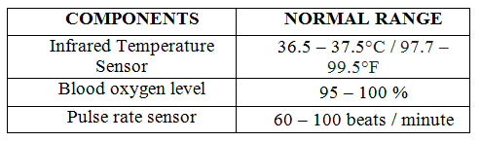
Results
Implementation and result of the model
Threshold values
Once the fingerprint is verified, health parameter monitoring takes place.
Data verification in cloud occurs.
If data mismatches, alert message is sent to guardian and doctor.
Normality status indication be like:
All values are normal
Temperature is abnormal
Blood oxygen level is abnormal
Pulse rate is abnormal

Slide 12
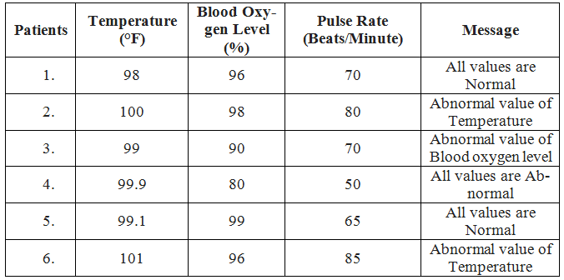
Results
Test samples and Normality status

Slide 13
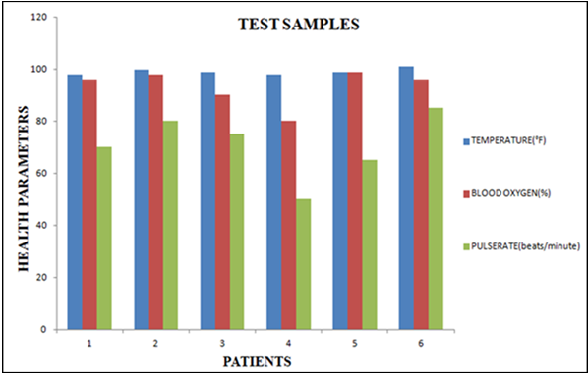
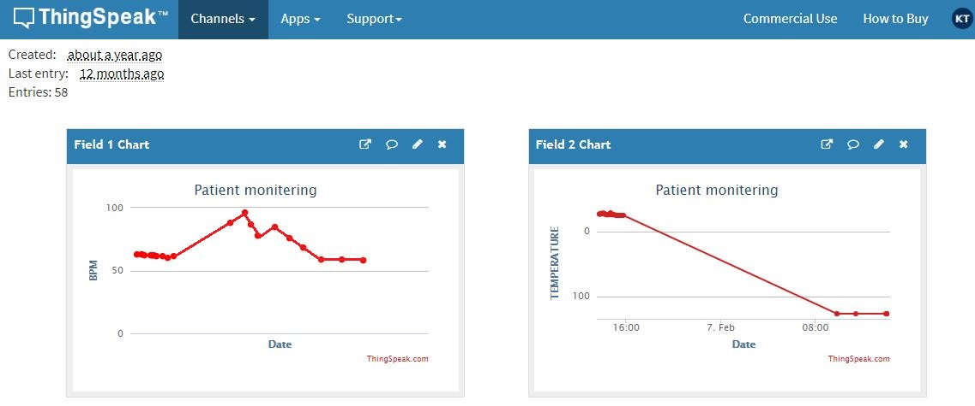
RESULTS
Test sample plot
Output

Slide 14
Conclusion
Proposed model - cost-efficient, reliable, user-friendly, security etc.
Helps elderly people, bedridden patients who require medical assistances every day.
Useful in rural areas to get quicker medical care.
Data maintenance and analysis helps doctor to diagnose the disorder of the patient
Future Work
Artificial intelligence can be implemented for improvement of the system.
Data mining – pattern based working , explores several data of patient , earlier prediction of disease.

Slide 15
References
1.Surekha N, Yamuna N, Akhil kumar J, Naveen Kumar KG, Rajesh Kumar Kaushal, Patient monitoring system using IOT, International Journal of Innovative Research in Advanced Engineering (IJIRAE), 2018.
2.Shivleela Patil, Sanjay Pardeshi, Health Monitoring System Using IOT, International Research Journal of Engineering and Technology (IRJET), 2018.
3. Shubhan Banka, Isha Madan, S.S. Saranya, Smart Health Monitoring Using IOT, International Journal of Applied Engineering Research, 2018.
4. Orge Gomez, Byron Oviedo, Emilio Zhuma, Patient Monitoring System Based on Internet of Things, Procedia Computer Science, Volume 83, 2016, Pages 90-97, ISSN 1877-0509.

Slide 16
THANK YOU

